Slide 1

Comparing Supervised Machine Learning Algorithms for Breast Cancer Diagnosis
Team 5:
Muhammad Hassan
Andreza dos Santos
Marivic Tanguin
Ahmed Abdelrahman

Slide 2

Overview
The study compares the performance of supervised machine learning algorithms using different evaluation metrics.
The report provides a detailed description of the data set used in the analysis.
A dashboard summarizes the features used in the analysis.
The research question and methodology are discussed in detail.
Results of the analysis, including performance evaluation metrics, are presented in the report
The report concludes with recommendations for future research and implications for future diagnostic outcomes.

Slide 3
Introduction
Breast cancer is the most commonly diagnosed cancer among women globally, with an estimated 2.3 million new cases and 685,000 deaths in 2020
By 2040 the breast cancer burden will increase to more than 3 million new cases per year (an increase of 40%) and more than 1 million deaths per year (an increase of 50%).
Machine learning algorithms have shown promise in improving the accuracy and efficiency of breast cancer diagnosis. Several models, including logistic regression, decision trees, random forests, support vector machines, neural networks, and K-Nearest Neighbors (KNN), have been applied to breast cancer diagnosis datasets to predict the presence or absence of malignancy.

Slide 4
Objectives
The study will develop and evaluate multiple machine learning models for diagnosing breast cancer using a publicly available dataset.
Six machine learning models will be compared to identify the one that performs best in predicting breast cancer diagnosis. The models include logistic regression, decision trees, random forests, support vector machines, neural networks, and KNN.
The study's results could have significant implications for improving the accuracy and efficiency of breast cancer diagnosis, which can lead to better diagnostic outcomes.

Slide 5


Slide 6
Data Extraction
Extracted from Kaggle - UCI Machine Learning
Dataset includes 30 features
Class distribution: 357 benign (B), 212 malignant (M).

Slide 7
Dataset Overview

Slide 8

Research Question
Among the various supervised learning algorithms to be evaluated in this study using the Breast Cancer Wisconsin dataset, which one performed the most effective in accurately classifying breast cancer as malignant or benign?

Slide 9
Methods
The problem of diagnosing breast cancer as malignant or benign is a binary classification problem, as there are only two possible outcomes. Supervised learning models are designed specifically for classification tasks, and therefore tend to be effective at predicting whether a patient has cancer or not.
Supervised learning algorithms explored are:
Logistic Regression
Decision Tree
Random Forest
Support Vector Machine (SVM)
Neural Network
K-Nearest-Neighbour (KNN)

Slide 10

Methods
Neural Network Optimization:
Scaling the Dataset
Adding an additional layer
Increasing the number of nodes in the first two layers
Increasing the number of Epochs
Classification reports are calculated based on the confusion matrix to provide a comprehensive summary of the model’s performance in terms of various evaluation metrics such as accuracy, precision, recall, and F1 score

Slide 11
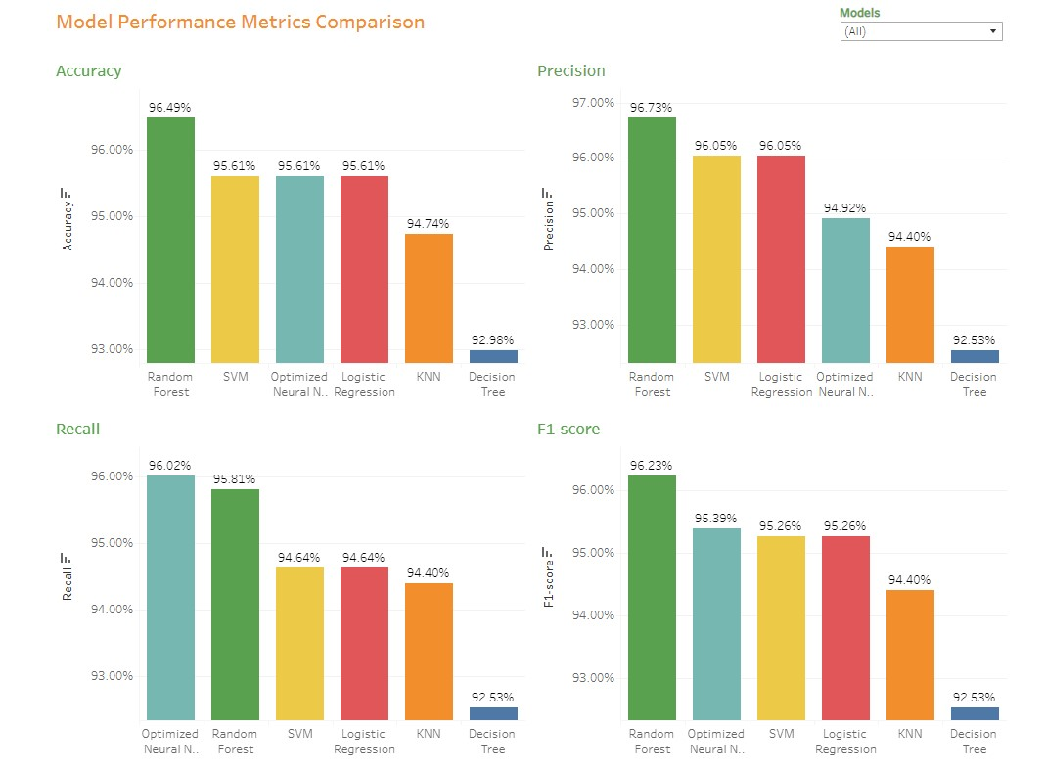
Model Performance Metric Comparison

Slide 12

Analysis
Which Metric is more important?
Accuracy: overall correctness of predictions
Recall: minimize false negatives (malignant as benign)
Precision: minimize false positives (benign as malignant)
F1 score: balanced measure of precision & recall
Importance: high precision & recall for patient outcomes

Slide 13
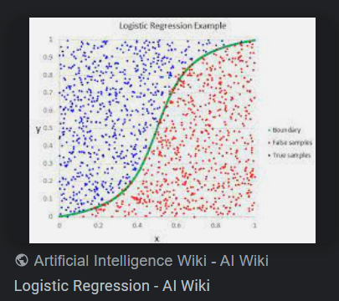
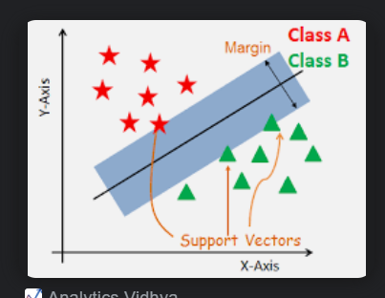
Analysis
Why did logistic regression and SVM yield similar results?
Both are linear models that perform well on linearly separable data
Binary classification focus
Optimizing decision boundaries
Similar Regularization techniques to avoid overfitting
Similar assumptions about data distribution

Slide 14

Conclusion
Given the described training/testing data set:
Random Forest:
Highest Accuracy (96.49%)
Top precision (96.73%)
Top F1-score (96.23%)
Optimized Neural Network
Top recall (96.02%)
Random Forest overall best performer, however performance differences between models are relatively minor

Slide 15

Recommendation
Deploy Random Forest model for this use case: High accuracy, precision, recall, and F1-score
Consider problem requirements for future use cases and emergence of new training data sets
Some algorithms may not scale well for large datasets, or non-linear data
Factors that affect future model selection::
Computational resources
Interpretability
Data set size

Slide 16


